Slide 1
2806 Neural Computation
Learning Processes Lecture 2
2005 Ari Visa

Slide 2
Agenda
Some historical notes
Learning
Five basic learning rules
Learning paradigms
The issues of learning tasks
Probabilistic and statistical aspects of the learning process
Conclusion

Slide 3
Overview
What is meant with learning?
The ability of the neural network (NN) to learn from its environment and to improve its performance through learning.
The NN is stimulated by an environment
The NN undergoes changes in its free parameteres
The NN responds in a new way to the environment

Slide 4
Some historical notes
Pavlov’s conditioning experiments: a conditioned response , salivation in response to the auditory stimulus
Hebb: The Organization of Behavior, 1949 -> Long-Term Potential, LPT, (1973 Bliss,Lomo), AMPA receptor, Long-Term Depression, LTD, NMDA receptor,
The nearest neigbbor rule Fix&Hodges 1951

Slide 5
Some historical notes
The idea of competive learning: von der Malsburg 1973, the self-organization of orientation-sensitive nerve cells in the striate cortex
Lateral inhibition ->Mach bands, Ernest Mach 1865
Statistical thermodynamics in the study of computing machinery, John von Neumann, Theory and Organization of Complicated Automata, 1949

Slide 6
Some historical notes
Reinforcement learning: Minsky 1961, Thorndike 1911
The problem of designing an optimum linear filter: Kolmogorov 1942, Wiener 1949, Zadeh 1953, Gabor 1954

Slide 7
Definition of Learning
Learning is a process by which the free parameters of a neural network are adapted through a process of stimulation by the environment in which the network is embedded. The type of the learning is determined by the manner in which the parameter changes take place. (Mendel & McClaren 1970)

Slide 8
Five Basic Learning Rules
Error-correction learning <- optimum filtering
Memory-based learning <- memorizing the training data explicitly
Hebbian learning <- neurobiological
Competitive learning <- neurobiological
Boltzmann learning <- statistical mechanics

Slide 9
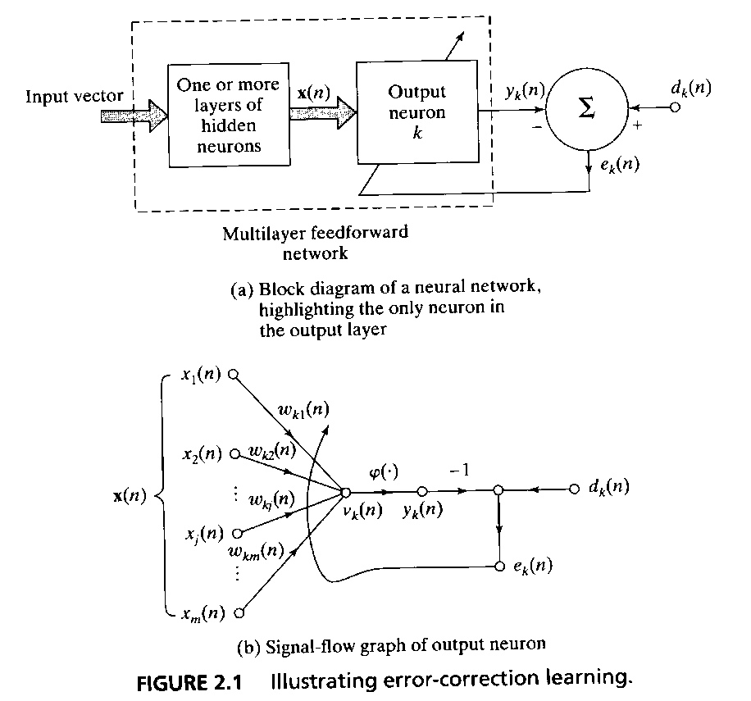
Five Basic Learning Rules 1/5
Error-Correction Learning
error signal = desired response – output signal
e_{k}(n) = d_{k}(n) –y_{k}(n)
e_{k}(n) actuates a control mechanism to make the output signal y_{k}(n) come closer to the desired response d_{k}(n) in step by step manner

Slide 10
Five Basic Learning Rules 1/5
A cost function ε(n) = ½e²_{k}(n) is the instantaneous value of the error energy -> a steady state
= a delta rule or Widrow-Hoff rule
Δw_{kj}(n) = η e_{k}(n) x_{j}(n),
η is the learning rate parameter
The adjustment made to a synaptic weight of a neuron is proportional to the product of the error signal and the input signal of the synapse in question.
w_{kj}(n+1) = w_{kj}(n) + Δw_{kj}(n)

Slide 11
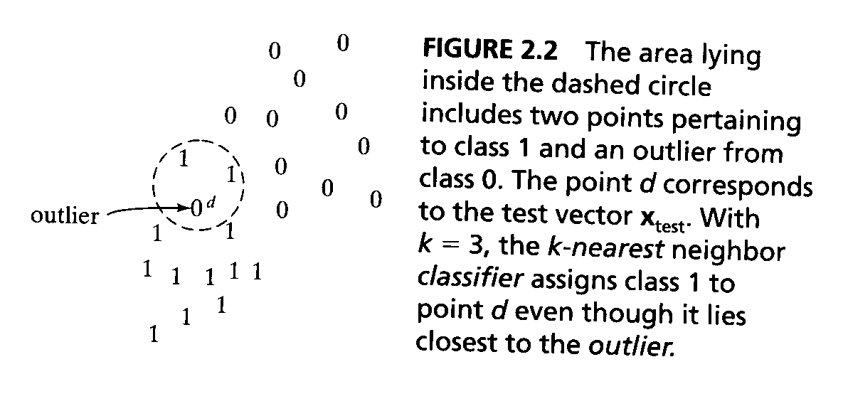
Five Basic Learning Rules 2/5
Memory-Based Learning: all of the past experiences are explicitly stored in a large memory of correctly classified input-output examples
{(x_{i},d_{i})}^{N} _{i=1}

Slide 12
Five Basic Learning Rules 2/5
Criterion used for defining the local neighbourhood of the test vector x_{test}.
Learning rule applied to the training examples in the local neighborhood of x_{test}.
Nearest neighbor rule: the vector x’_{N} ∈{x₁,x₂,...,x_{N}} is the nearest neighbor of x_{test} if min_{i} d(x_{i}, x_{test} ) = d(x’_{N} , x_{test} )

Slide 13
Five Basic Learning Rules 2/5
If the classified examples d(x_{i}, d_{i} ) are independently and identically distributed according to the joint probability distribution of the example (x,d).
If the sample size N is infinitely large.
The classification error incurred by the nearest neighbor rule is bounded above twice the Bayes probability of error.

Slide 14
Five Basic Learning Rules 2/5
k-nearest neighbor classifier:
Identify the k classified patterns that lie nearest to the test vector x_{test} for some integer k.
Assign x_{test} to the class that is most frequently represented in the k nearest neighbors to x_{test} .

Slide 15
Five Basic Learning Rules 3/5
Hebbian Learning:
1. If two neurons on either side of synapse (connection) are activated simultaneously, then the strength of that synapse is selectively increased.
2. If two neurons on either side of a synapse are activated asynchronously, then that synapse is selectively weakened or eliminated.

Slide 16
Five Basic Learning Rules 3/5
1. Time-dependent mechanism
2. Local mechanism (spatiotemporal contiguity)
3. Interactive mechanism
4. Conjunctional or correlational mechanism
->A Hebbian synapse increases its strength with positively correlated presynaptic and postsynaptic signals, and decreases its strength when signals are either uncorrelated or negatively correlated.

Slide 17
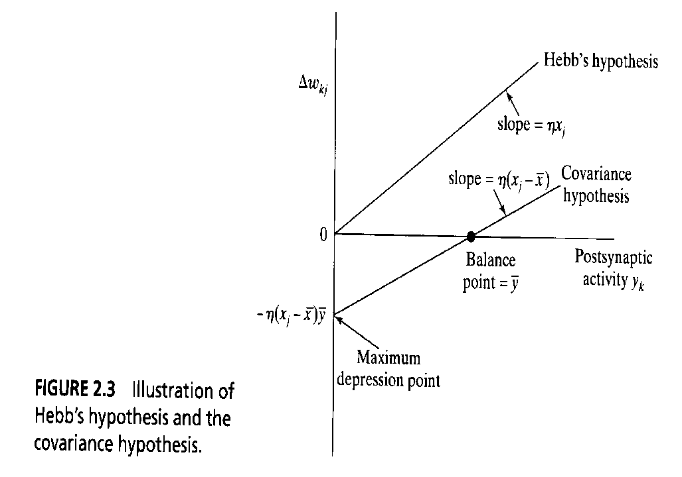
Five Basic Learning Rules 3/5
The Hebbian learning in matematical terms:
Δw_{kj}(n)=F(y_{k}(n),x_{j}(n))
The simplest form:
Δw_{kj}(n) = ηy_{k}(n)x_{j}(n)
Covariance hypothesis:
Δw_{kj} = η(x_{j}-‾x)(y_{j}-‾y)

Slide 18
Five Basic Learning Rules 3/5
Note, that:
1. Synaptic weight w_{kj} is enhanced if the conditions x_{j} >‾x and y_{k} >‾y are both satisfied.
2. Synaptic weight w_{kj} is depressed if there is x_{j} >‾x and y_{k} <‾y or
y_{k} >‾y and x_{j} <‾x .

Slide 19
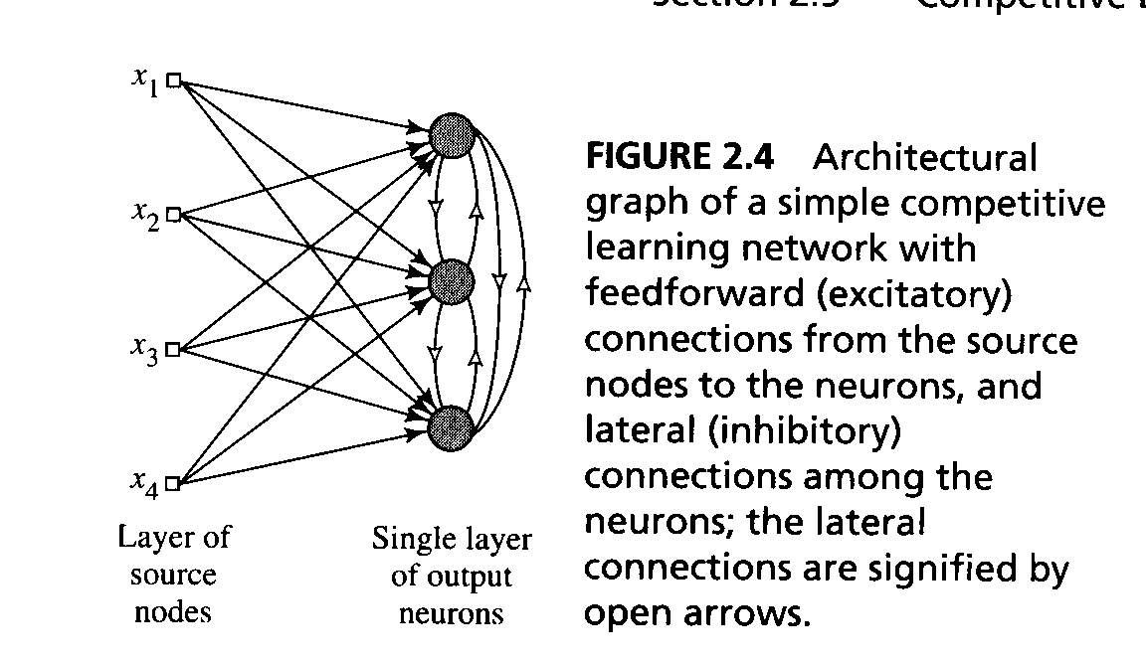
Five Basic Learning Rules 4/5
Competitive Learning:
The output neurons of a neural network compete among themselves to become active.
- a set of neurons that are all the same (excepts for synaptic weights)
- a limit imposed on the strength of each neuron
- a mechanism that permits the neurons to compete -> a winner-takes-all

Slide 20
Five Basic Learning Rules 4/5
The standard competitive learning rule
Δw_{kj} = η(x_{j}-w_{kj}) if neuron k wins the competition = 0 if neuron k loses the competition
Note. all the neurons in the network are constrained to have the same length.

Slide 21
Five Basic Learning Rules 5/5
Boltzmann Learning:
The neurons constitute a recurrent structure and they operate in a binary manner. The machine is characterized by an energy function E.
E = -½Σ_{j}Σ_{k} w_{kj}x_{k}x_{j} , j≠k
Machine operates by choosing a neuron at random then flipping the state of neuron k from state x_{k} to state –x_{k} at some temperature T with probability
P(x_{k}→ - x_{k}) = 1/(1+exp(- ΔE_{k}/T))

Slide 22
Five Basic Learning Rules 5/5
Clamped condition: the visible neurons are all clamped onto specific states determined by the environment
Free-running condition: all the neurons (=visible and hidden) are allowed to operate freely
The Boltzmann learning rule:
Δw_{kj} = η(ρ⁺_{kj}- ρ⁻_{kj}), j≠k,
note that both ρ⁺_{kj} and ρ⁻_{kj} range in value from –1 to +1.

Slide 23
Learning Paradigms
Credit assignment: The credit assigment problem is the problem of assigning credit or blame for overall outcomes to each of the internal decisions made by the learning machine and which contributed to those outcomes.
1. The temporal credit-assignment problem in that it involves the instants of time when the actions that deserve credit were actually taken.
2. The structural credit-assignment problem in that it involves assigning credit to the internal structures of actions generated by thesystem.

Slide 24
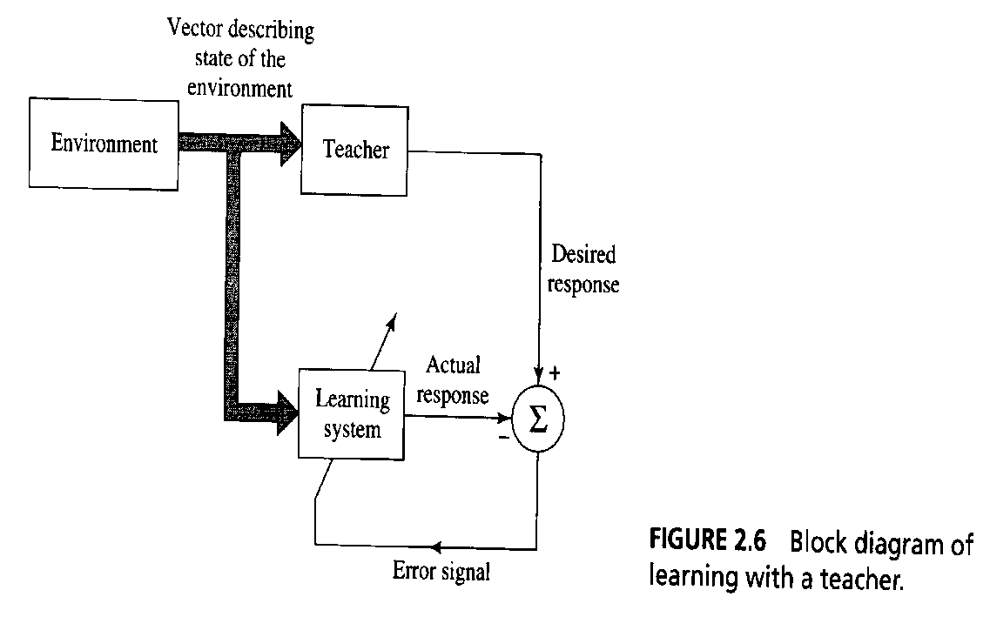
Learning Paradigms
Learning with a Teacher (=supervised learning)
The teacher has knowledge of the environment
Error-performance surface

Slide 25
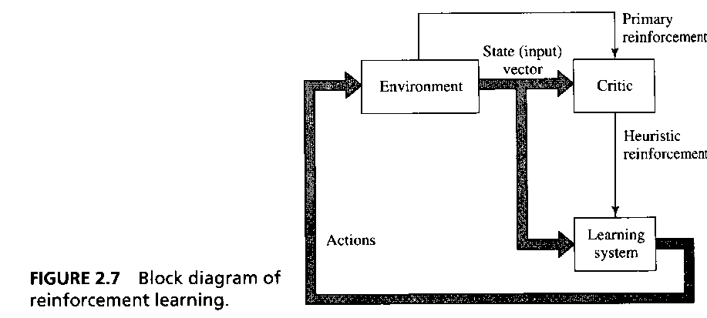
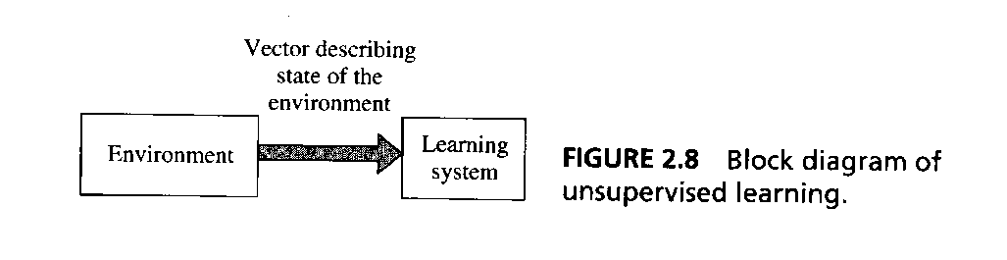
Learning Paradigms
Learning without a Teacher: no labeled examples available of the function to be learned.
1) Reinforcement learning
2) Unsupervised learning

Slide 26
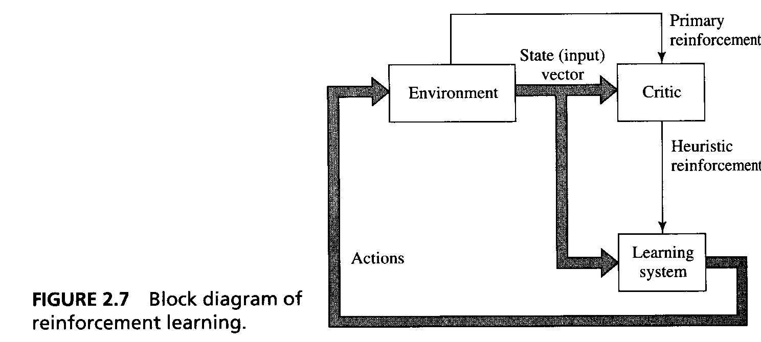
Learning Paradigms
1) Reinforcement learning: The learning of input-output mapping is performed through continued interaction with the environment in oder to minimize a scalar index of performance.

Slide 27
Learning Paradigms
Delayed reinforcement, which means that the system observes a temporal sequence of stimuli.
Difficult to perform for two reasons:
- There is no teacher to provide a desired response at each step of the learning process.
- The delay incurred in the generation of the primary reinforcement signal implies that the machine must solve a temporal credit assignment problem.
Reinforcement learning is closely related to dynamic programming.

Slide 28
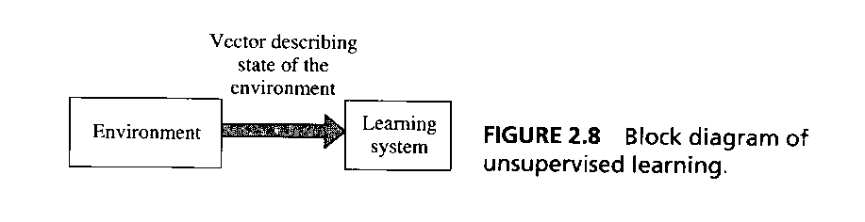
Learning Paradigms
Unsupervised Learning: There is no external teacher or critic to oversee the learning process.
The provision is made for a task independent measure of the quality of representation that the network is required to learn.

Slide 29
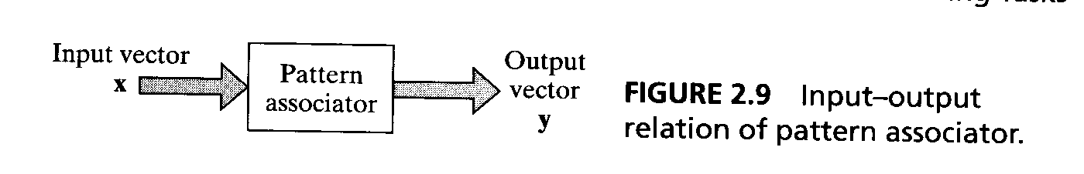
The Issues of Learning Tasks
An associative memory is a brainlike distributed memory that learns by association.
Autoassociation: A neural network is required to store a set of patterns by repeatedly presenting then to the network. The network is presented a partial description of an originalpattern stored in it, and the task is to retrieve that particular pattern.
Heteroassociation: It differs from autoassociation in that an arbitary set of input patterns is paired with another arbitary set of output patterns.

Slide 30
The Issues of Learning Tasks
Let x_{k} denote a key pattern and y_{k} denote a memorized pattern. The pattern association is decribed by
x_{k}→ y_{k}, k = 1,2, ... ,q
In an autoassociative memory x_{k}= y_{k}
In a heteroassociative memory x_{k}≠ y_{k.}
Storage phase
Recall phase
q is a direct measure of the storage capacity.

Slide 31
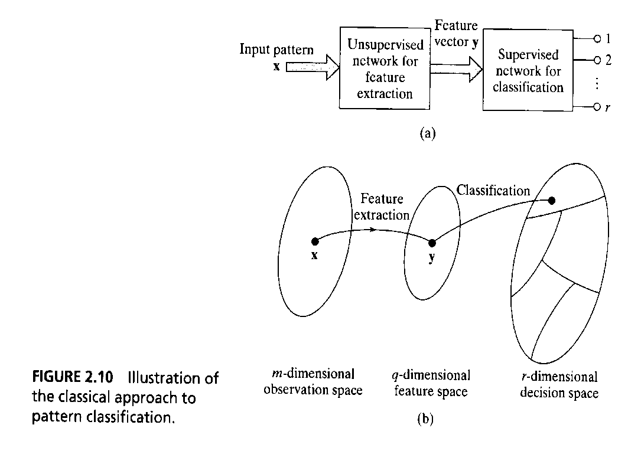
The Issues of Learning Tasks
Pattern Recognition: The process whereby a received pattern/signal is assigned to one of a prescribed number of classes

Slide 32
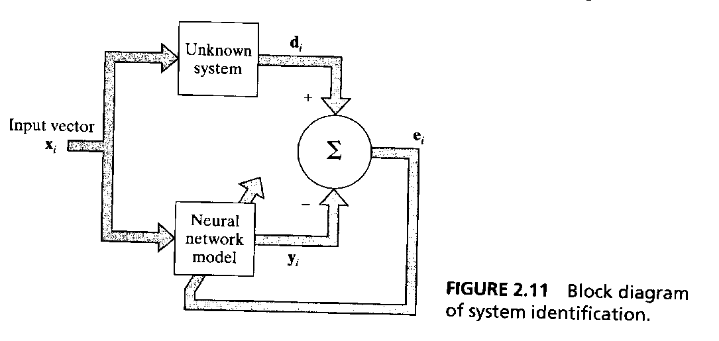
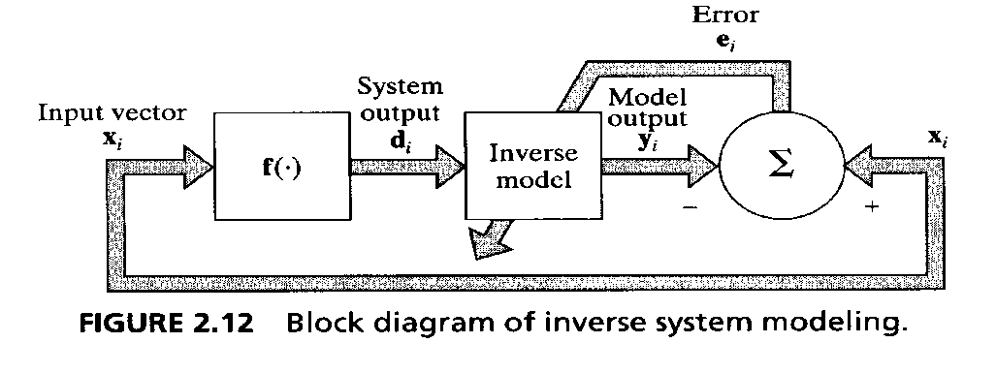
The Issues of Learning Tasks
Function Approximation:
Consider a nonlinear input-output mapping
d =f(x)
The vector x is the input and the vector d is the output. The function f(.) is assumed to be unknown. The requirement is todesign a neural network that approximates the unknown function f(.) .
⏐⏐F(x)-f(x)⏐⏐<ε for all x
System identification
Inverse system

Slide 33
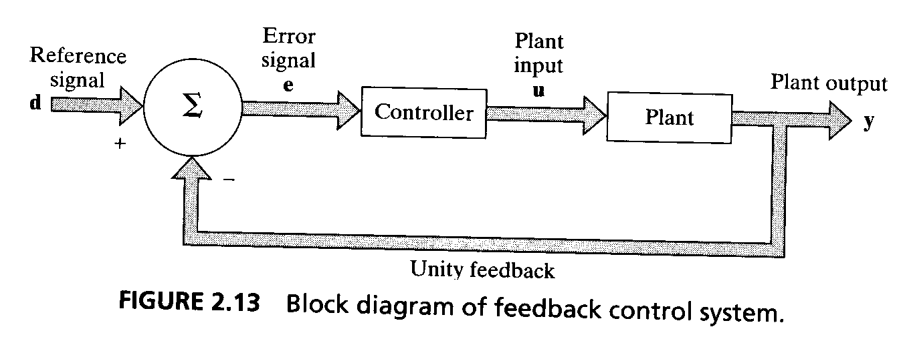
The Issues of Learning Tasks
Control: The controller has to invert the plant’s input-output behavior.
Indirect learning
Direct learning

Slide 34
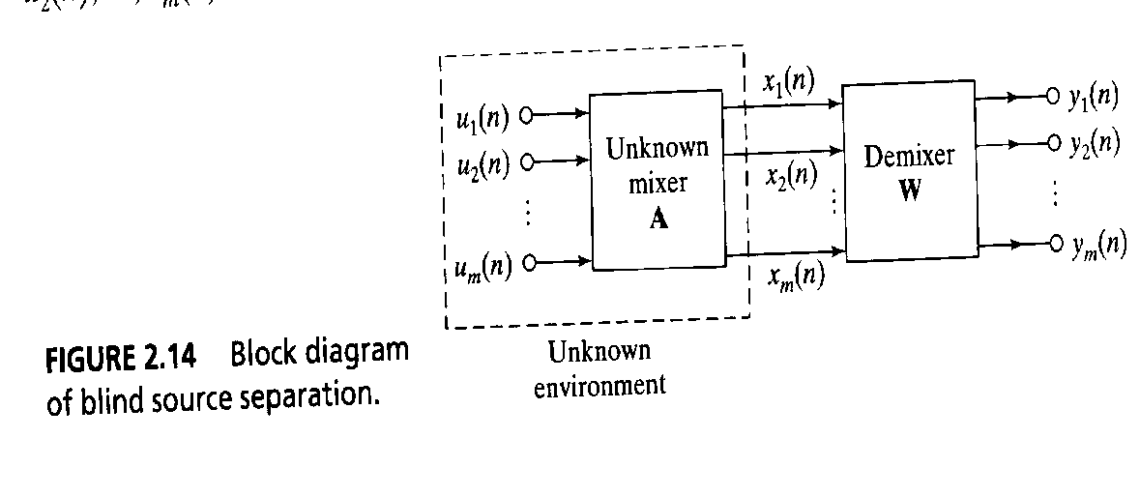
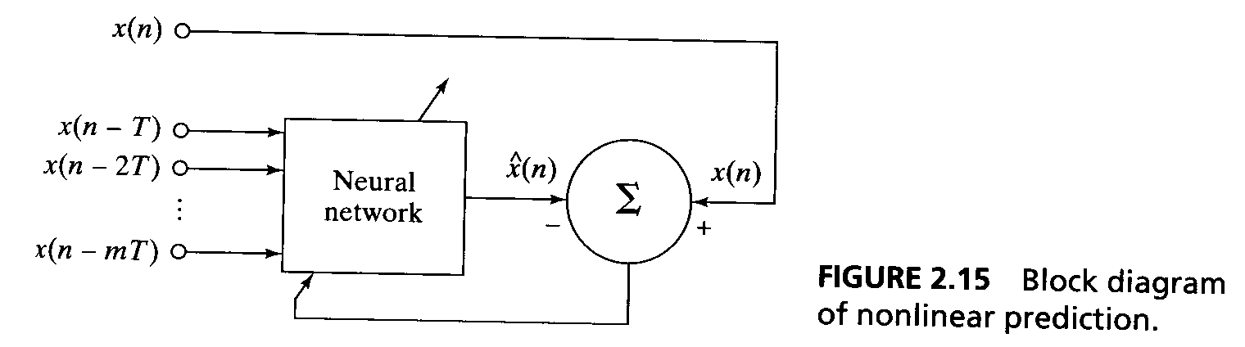
The Issues of Learning Tasks
Filtering
Smoothing
Prediction
Coctail party problem -> blind signal separation

Slide 35
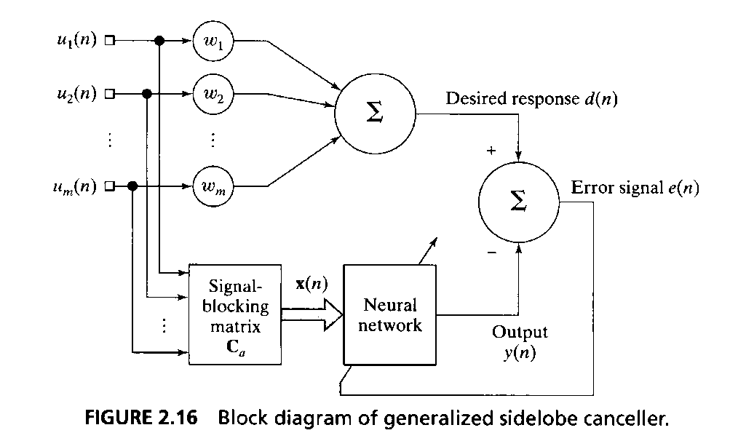
The Issues of Learning Tasks
Beamforming: used in radar and sonar systems where the primary target is to detect and track a target.

Slide 36
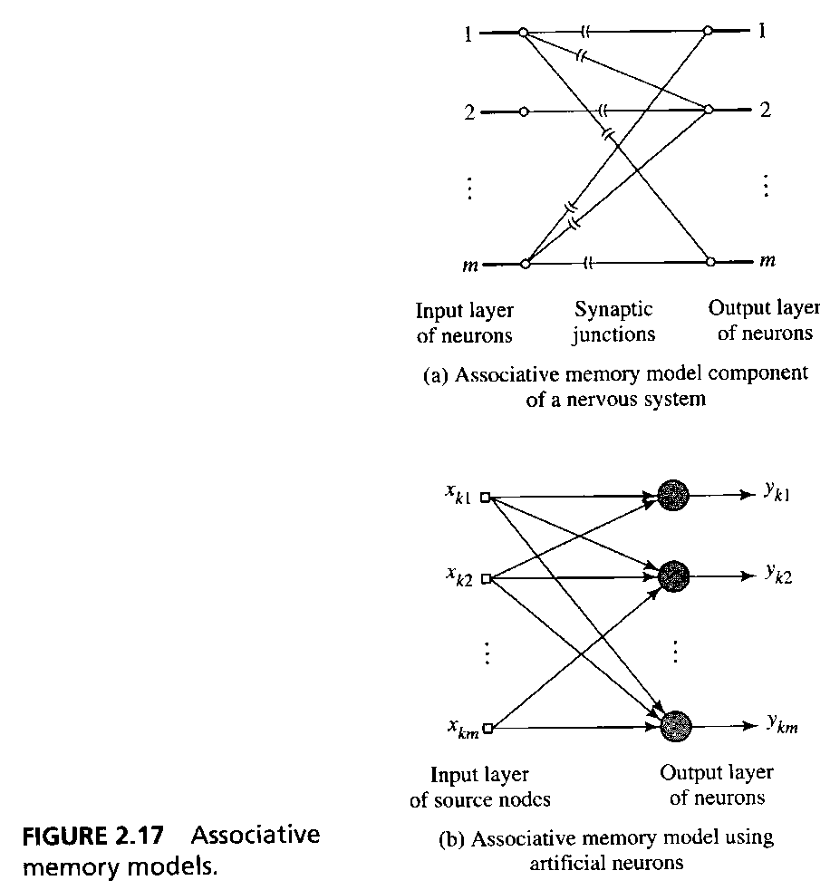
The Issues of Learning Tasks
Memory: associative memory models
Correlation Matrix Memory

Slide 37
The Issues of Learning Tasks
Adaptation: It is desirable for a neural network to continually adapt its free parameters to variations in the incoming signals in a real-time fashion.
Pseudostationary over a window of short enough duration.
Continual training with time-ordered examples.

Slide 38
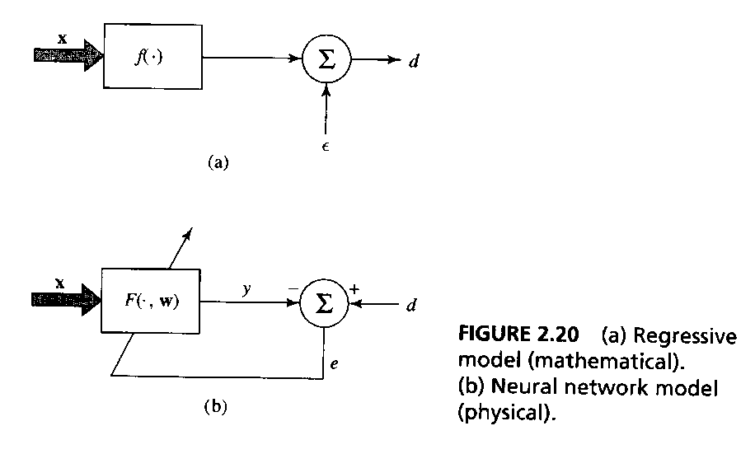
Probabilistic and Statistical Aspects of the Learning Process
We do not have knowledge of the exact functional relationship between X and D ->
D = f(X) + ε, a regressive model
The mean value of the expectational error ε, given any realization of X, is zero.
The expectational error ε is uncorrelated with the regression function f(X).

Slide 39
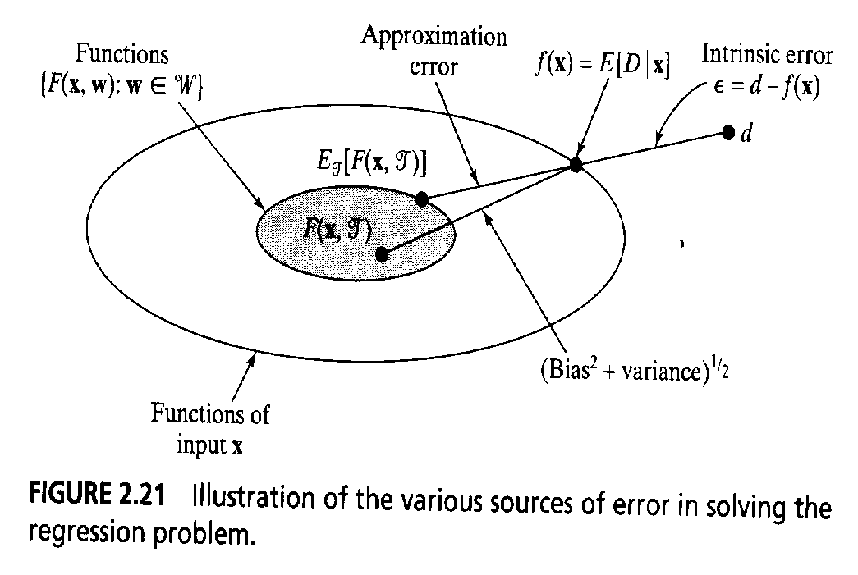
Probabilistic and Statistical Aspects of the Learning Process
Bias/Variance Dilemma
L_{av}(f(x),F(x,T)) = B²(w)+V(w)
B(w) = E_{T}[F(x,T)]-E[D|X=x] (an approximation error)
V(w) = E_{T}[(F(x,T)-E_{T}[F(x,T)])² ] (an estimation error)
NN -> small bias and large variance
Introduce bias -> reduce variance

Slide 40
Probabilistic and Statistical Aspects of the Learning Process
Vapnic-Chervonenkis dimension is a measure of the capacity or expressive power of the family of classification functions realized by the learning machine.
VC dimension of T is the largest N such that Δ_{T}(N) = 2^{N}. The VC dimension of the set of classification functions is the maximum number of training examples that can be learned by the machine without error for all possible binary labelings of the classification functions.

Slide 41
Probabilistic and Statistical Aspects of the Learning Process
Let N denote an arbitary feedforward network built up from neurons with a threshold (Heaviside) activation function. The VC dimension of N is O(WlogW) where W is the total number of free parameters in the network.
Let N denote a multilayer feedforward network whose neurons use a sigmoid activation function
f(v)=1/(1+exp(- v)).
The VC dimension of N is O(W²) where W is the total number of free parameters in the network

Slide 42
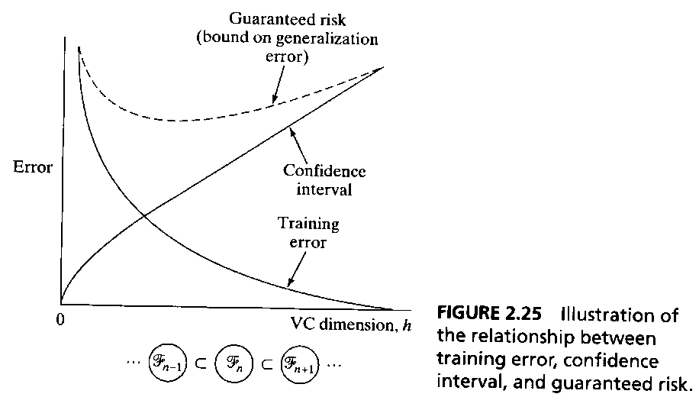
Probabilistic and Statistical Aspects of the Learning Process
The method of structural risk minimization
v_{guarant}(w) = v _{train}(w) + ε₁(N,h,α,v_{train})

Slide 43
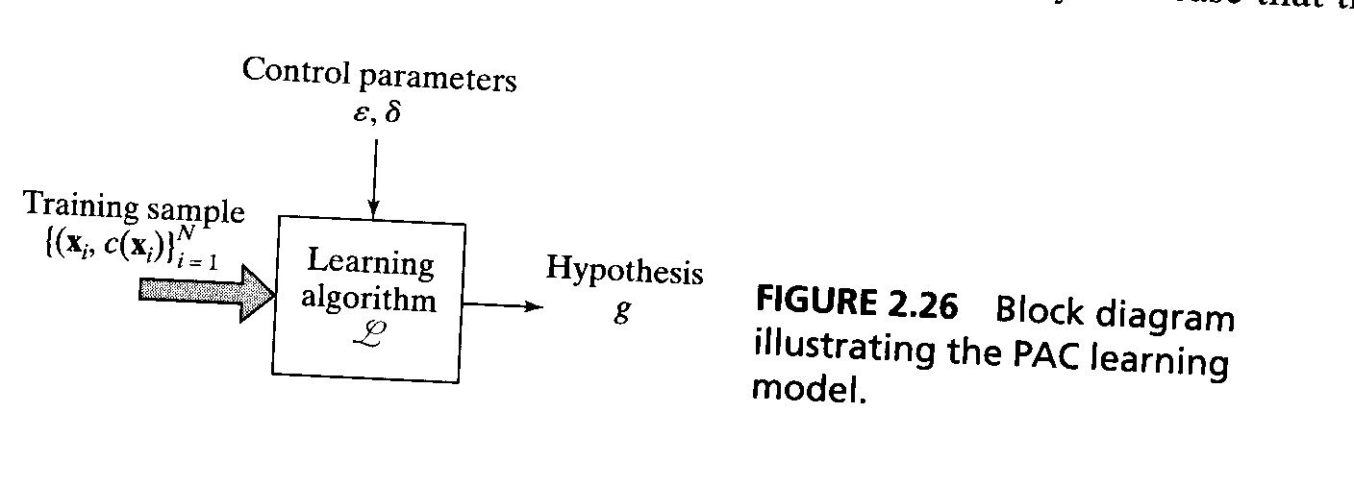
Probabilistic and Statistical Aspects of the Learning Process
The probably approximately correct (PAC)
1. Any consistent learning algorithm for that neural network is a PAC learning algorithm.
2. There is a constant K such that a sufficient size of training set T for any such algorithm is
N = K/ε(h log(1/ ε) + log(1/δ))
where ε is the error paramater and δ is the confidence parameter.

Slide 44
Summary
The five learning rules: Error-correction learning, Memory-based learning, Hebbian learning, Competitive learning and Boltzmann learning
Statistical and probabilistic aspects of learning

